Slide 1
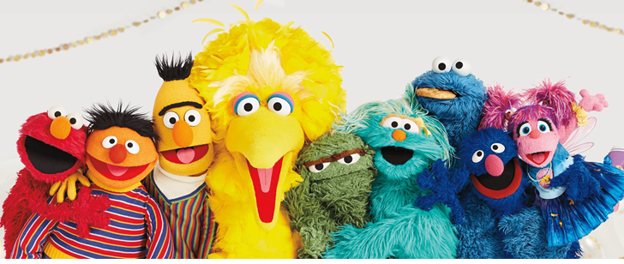
Self-Supervised Learning
https://www.sesameworkshop.org/what-we-do/sesame-streets-50th-anniversary
Hung-yi Lee 李宏毅

Slide 2

死臭酸宅本人
芝麻街

Slide 3

ERNIE (Enhanced Representation through Knowledge Integration)
Big Bird: Transformers for Longer Sequences
BERT (Bidirectional Encoder Representations from Transformers)
ELMo (Embeddings from Language Models)
Notes:
BERT & PALs
(Projected Attention Layers)

Slide 4


BERT
Bertolt Hoover
340M
parameters
Source of image: https://leemeng.tw/attack_on_bert_transfer_learning_in_nlp.html
Notes:
超巨大巨人
諫ㄐㄧㄢˋ山創
貝爾托特·胡佛
Bertholdt Hoover
「進擊的巨人可以窺視未來繼承 者的記憶，也就是說它能看到未來。」

Slide 5
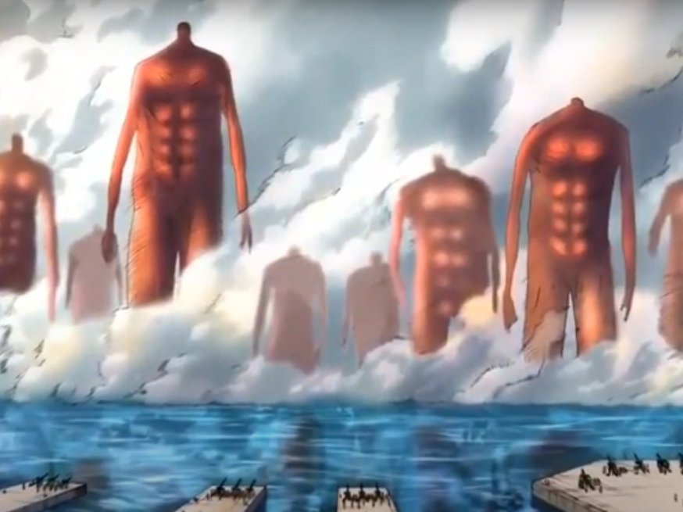
GPT-3
Source: https://youtu.be/wJJnjzNlMws
T5
GPT-2
BERT
ELMo

Slide 6
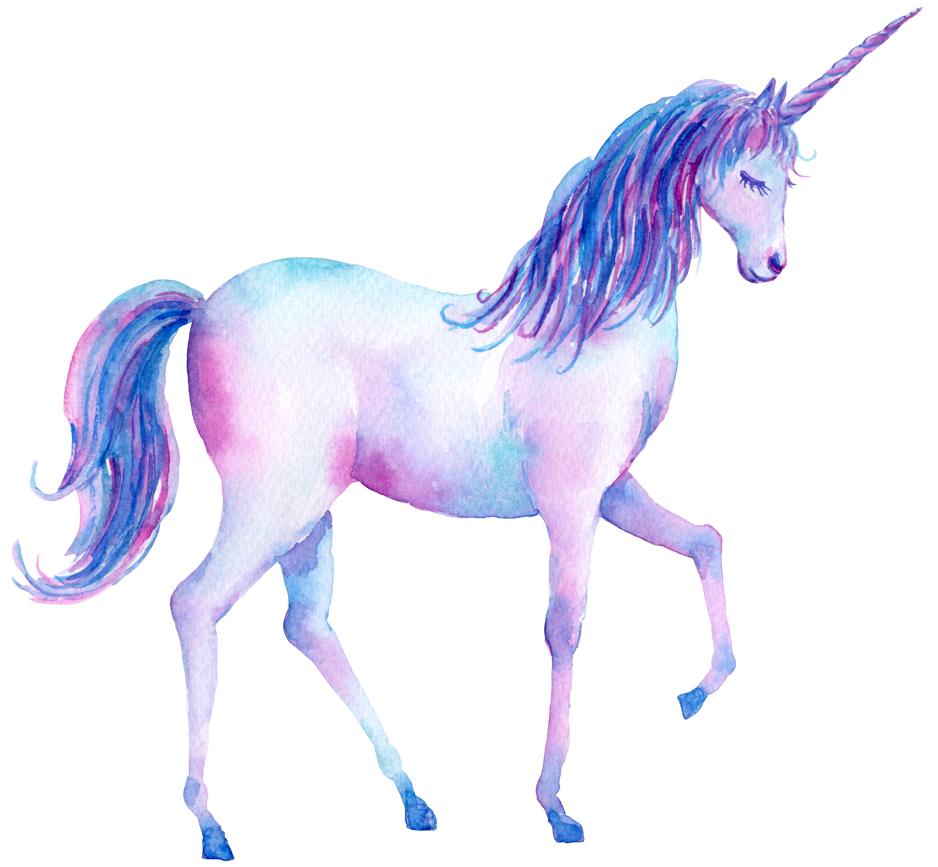
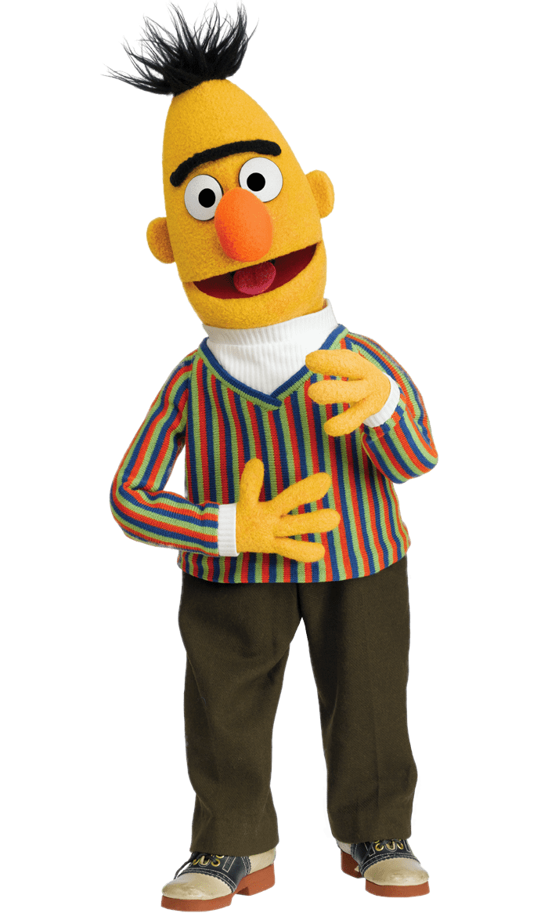

The models become larger and larger …
BERT (340M)
ELMO (94M)
GPT-2 (1542M)
Source of image: https://huaban.com/pins/1714071707/
Notes:
https://d4mucfpksywv.cloudfront.net/better-language-models/language_models_are_unsupervised_multitask_learners.pdf
93.6M
340M
1542M
40 GB

Slide 7

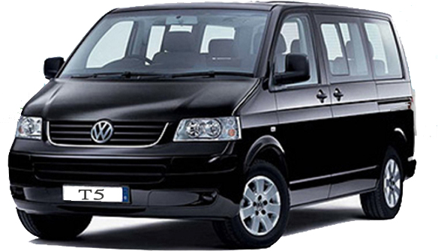
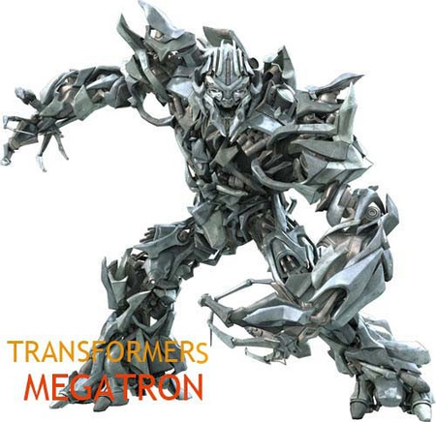
The models become larger and larger …
Turing NLG (17B)
GPT-3 is 10 times larger than Turing NLG.
GPT-2
Megatron (8B)
T5 (11B)

Slide 8
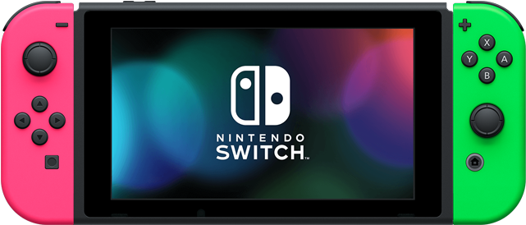
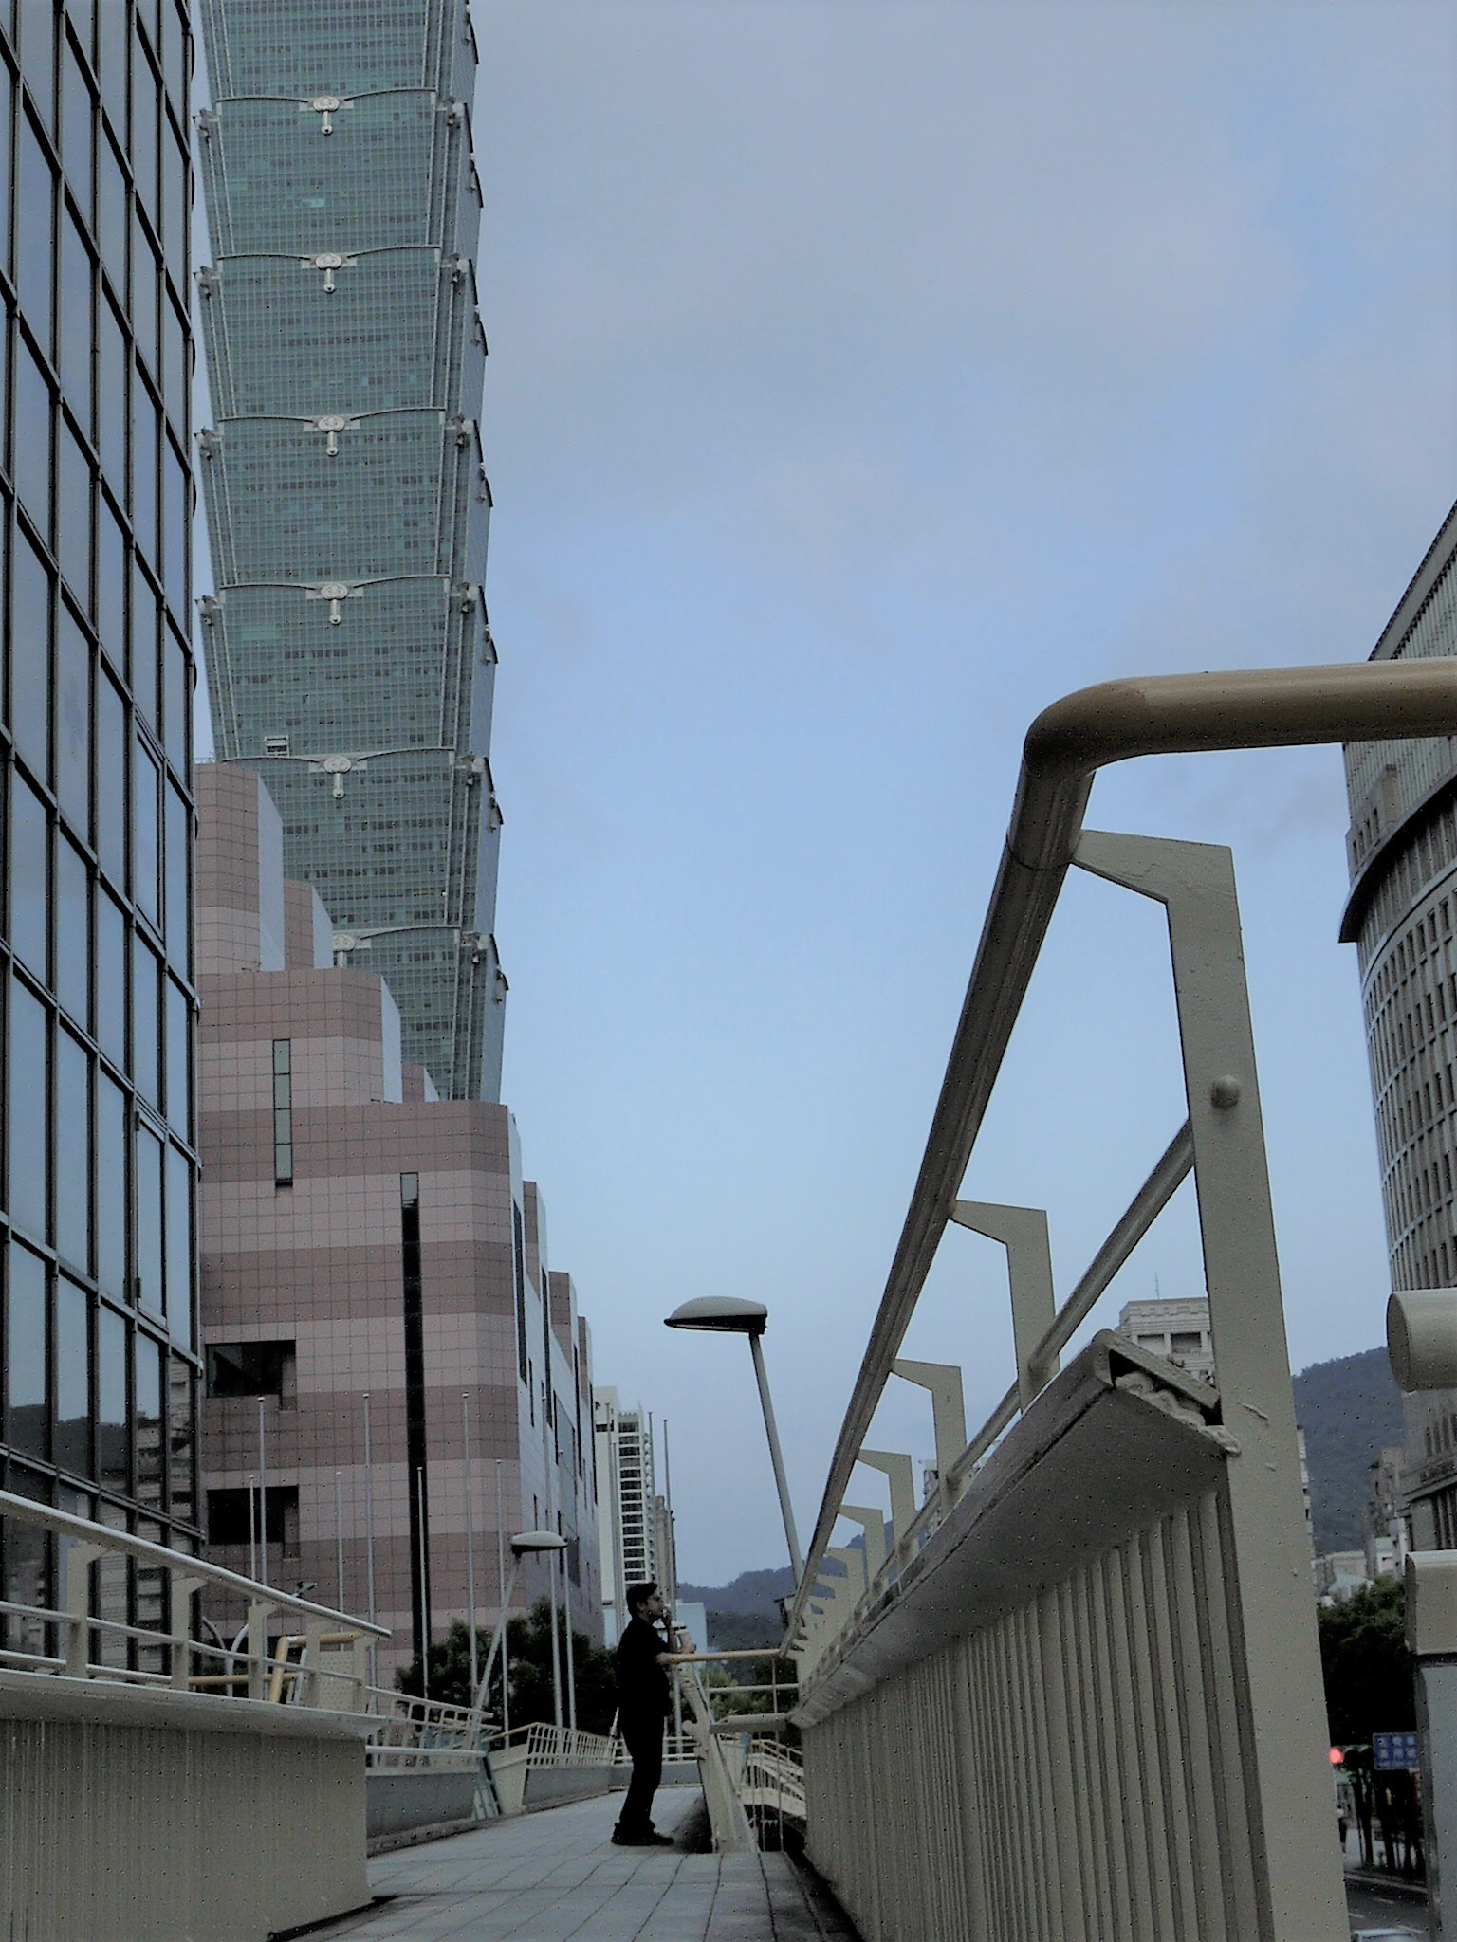
GPT-3
BERT (340M)
GPT-3 (175B)
Switch Transformer (1.6T)
死臭酸宅本人
BERT
https://arxiv.org/abs/2101.03961
Notes:
Switch! 比玉山高

Slide 9
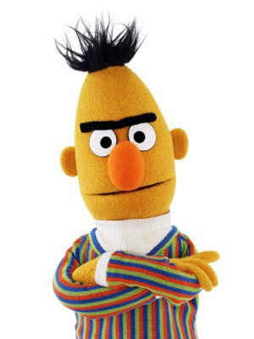
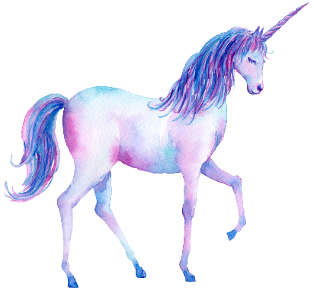
Outline
BERT series
GPT series

Slide 10

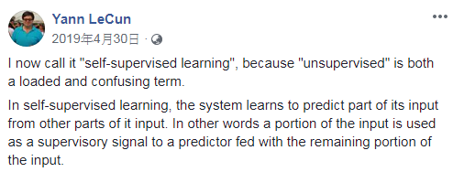
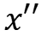
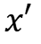
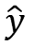
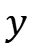
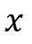
Self-supervised Learning
Self-supervised
Supervised
$$y$$
$$\hat{y}$$
$$y$$
$$x′′$$
label
Model
Model
$$x$$
$$x$$
$$x′$$

Slide 11
Masking Input
學 | 0.1
灣 | 0.7
台 | 0.1
大 | 0.1
…… | ……
https://arxiv.org/abs/1810.04805
softmax
=
(special token)
Linear
MASK
(all characters)
or
=
Random
一、天、大、小 …
Transformer
Encoder
BERT
Randomly masking some tokens
台
灣
大
學

Slide 12
Masking Input
Ground truth
https://arxiv.org/abs/1810.04805
minimize cross entropy
softmax
灣
=
(special token)
Linear
MASK
or
=
Random
一、天、大、小 …
Transformer
Encoder
BERT
Randomly masking some tokens
台
灣
大
學

Slide 13
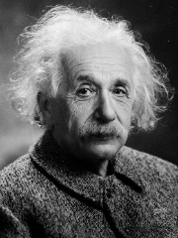
Next Sentence Prediction
This approach is not helpful.
Linear
Robustly optimized BERT approach (RoBERTa)
Yes/No
https://arxiv.org/abs/1907.11692
SOP: Sentence order prediction
Used in ALBERT
https://arxiv.org/abs/1909.11942
BERT
[CLS]
w₁
w₂
[SEP]
w₃
w₄
w₅
Sentence 1
Sentence 2
Notes:
[CLS] stands for classification.

Slide 14

BERT
Self-supervised Learning
Masked token prediction
Next sentence prediction
Pre-train
Fine-tune
Model for Task 1
Model for Task 2
Model for Task 3
Downstream Tasks
The tasks we care
We have a little bit labeled data.
Notes:
Downstream Tasks : the task you really want to solve
Better than directly using labeld data

Slide 15
GLUE
General Language Understanding Evaluation (GLUE)
https://gluebenchmark.com/
Corpus of Linguistic Acceptability (CoLA)
Stanford Sentiment Treebank (SST-2)
Microsoft Research Paraphrase Corpus (MRPC)
Quora Question Pairs (QQP)
Semantic Textual Similarity Benchmark (STS-B)
Multi-Genre Natural Language Inference (MNLI)
Question-answering NLI (QNLI)
Recognizing Textual Entailment (RTE)
Winograd NLI (WNLI)
GLUE also has Chinese version (https://www.cluebenchmarks.com/)
Notes:
COLA: Each example is a sequence of words annotated with whether it is a grammatical English sentence
MRPC: with human annotations for whether the sentences in the pair are semantically equivalent
QQP:o determine whether a pair of questions are semantically equivalent.
STS: Each pair is human-annotated with a similarity score from 1 to 5; the task is to predict these scores

Slide 16
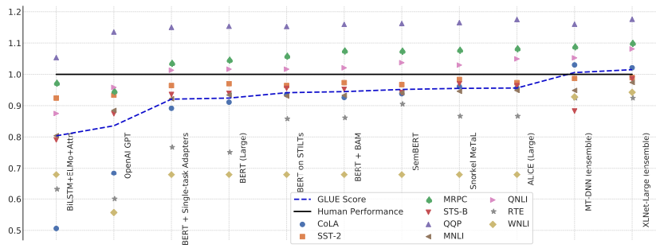
BERT and its Family
GLUE scores
Source of image: https://arxiv.org/abs/1905.00537

Slide 17
How to use BERT – Case 1
class
Input: sequence
output: class
Linear
Random initialization
Example:
Sentiment analysis
Better than random
this is good
Init by pre-train
BERT
positive
This is the model to be learned.
[CLS]
w₁
w₂
w₃
sentence
Notes:
Do I have to mention adaptor???
(https://arxiv.org/abs/1805.12471)

Slide 18
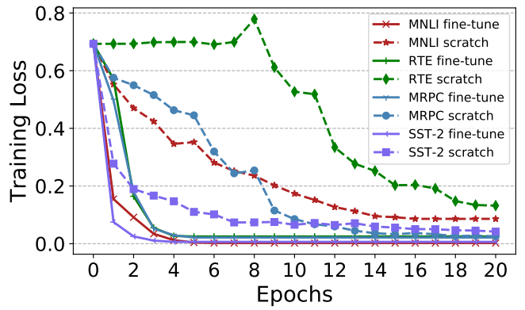
Pre-train v.s. Random Initialization
(fine-tune)
(scratch)
Source of image: https://arxiv.org/abs/1908.05620

Slide 19


Slide 20
How to use BERT – Case 2
class
class
class
Input: sequence
output: same as input
Linear
Linear
Linear
Example:
POS tagging
I saw a saw
BERT
N
V
DET
N
[CLS]
w₁
w₂
w₃
sentence
Notes:
(https://arxiv.org/abs/1805.12471)

Slide 21
How to use BERT – Case 3
Input: two sequences
Output: a class
Example:
Natural Language Inferencee (NLI)
contradiction
entailment
neutral
premise: A person on a horse jumps over a broken down airplane
Model
hypothesis: A person is at a diner.
contradiction
Notes:
premise前提

Slide 22
How to use BERT – Case 3
Class
Input: two sequences
Output: a class
Linear
BERT
[CLS]
w₁
w₂
[SEP]
w₃
w₄
w₅
Sentence 1
Sentence 2
Notes:
determining whether a “hypothesis” is true (entailment), false (contradiction), or undetermined (neutral) given a “premise”.

Slide 23
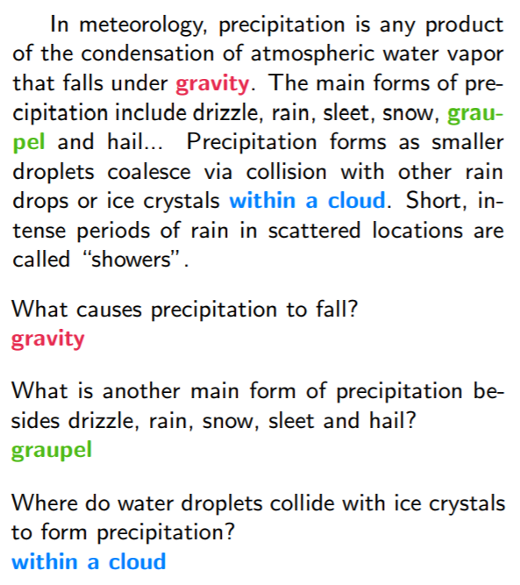
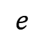
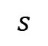
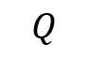
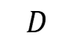
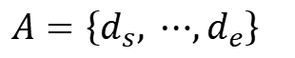
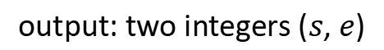
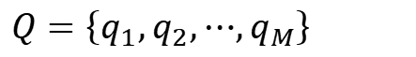
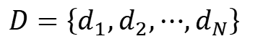
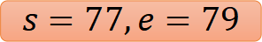
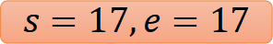
How to use BERT – Case 4
Extraction-based Question Answering (QA)
17
Document:
$$D=\left\{d_{1},d_{2},⋯,d_{N}\right\}$$
Query:
$$Q=\left\{q_{1},q_{2},⋯,q_{M}\right\}$$
77
79
$$D$$
QA
Model
$$s$$
$$e$$
$$s=17,e=17$$
$$Q$$
output: two integers ($s$, $e$)
Answer:
$$A=\left\{d_{s}, ⋯,d_{e}\right\}$$
$$s=77,e=79$$
Notes:
(E.g. SQuAD)

Slide 24
How to use BERT – Case 4
Random Initialized
0.3
0.5
0.2
s = 2
Softmax
inner product
BERT
[CLS]
q₁
q₂
[SEP]
d₁
d₂
d₃
question
document
Notes:
determining whether a “hypothesis” is true (entailment), false (contradiction), or undetermined (neutral) given a “premise”.

Slide 25
How to use BERT – Case 4
Random Initialized
0.1
0.2
0.7
s = 2
e = 3
Softmax
The answer is “d₂ d₃”.
inner product
BERT
[CLS]
q₁
q₂
[SEP]
d₁
d₂
d₃
question
document
Notes:
determining whether a “hypothesis” is true (entailment), false (contradiction), or undetermined (neutral) given a “premise”.

Slide 26

That is all about BERT!

Slide 27
Training BERT is challenging!
台達電產學合作計畫研究成果
This work is done by 姜成翰
Training data has more than 3 billions of words.
3000 times of Harry Potter series
Google’s ALBERT-base
Google’s BERT-base
Our ALBERT-base
https://arxiv.org/abs/2010.02480
8 days with TPU v3
GLUE scores
Notes:
(哈利波特全套約 100 萬個詞)
BERT (一個巨大的 LM) 用了 30 億個以上的詞
=====
12500 x 60 x 130 = 97,500,000 (將近 一億)
English Gigaword corpus (1200M words
the Harry Potter books contain 1,084,170 words.
At a typical speaking pace of 130 words per minute, a 1 minute speech will be about 130 words.
https://wordcounter.net/blog/2015/11/23/10922_how-many-words-harry-potter.html

Slide 28
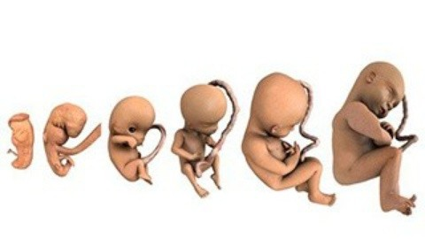
BERT Embryology (胚胎學)
https://arxiv.org/abs/2010.02480
When does BERT know POS tagging, syntactic parsing, semantics?
The answer is counterintuitive!
Notes:
some spoil here

Slide 29
Pre-training a seq2seq model
Reconstruct the input
w₁
w₂
w₃
w₄
w₅
w₆
w₇
w₈
Cross Attention
Encoder
Decoder
w₁
w₂
w₃
w₄
Corrupted
Notes:
[Song, et al., ICML’19]
[Lewis, et al., arXiv’19]

Slide 30
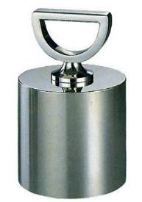

MASS / BART
MASS
A B [SEP] C D E
A B [SEP] C E
BART
(Delete “D”)
A B [SEP] C D E
C D E [SEP] A B
(permutation)
D E A B [SEP] C
(rotation)
https://arxiv.org/abs/1905.02450
https://arxiv.org/abs/1910.13461
A B [SEP] E
Text Infilling
Notes:
Permutation / Rotation do not perform well.
Text Infilling is consistently good.

Slide 31

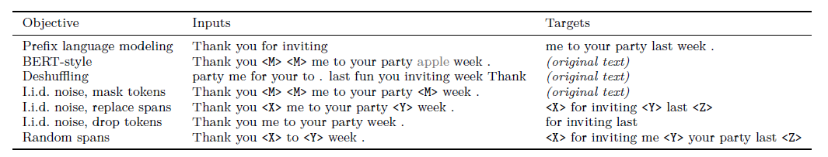
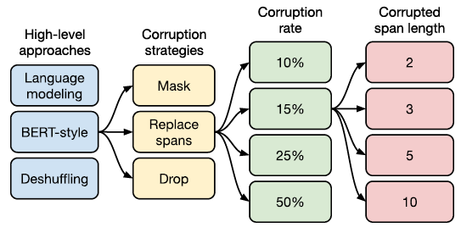
T5 – Comparison
Transfer Text-to-Text Transformer (T5)
Colossal Clean Crawled Corpus (C4)
Notes:
The C4 dataset we created for unsupervised pre-training is available in TensorFlow Datasets, but it requires a significant amount of bandwidth for downloading the raw Common Crawl scrapes (~7 TB) and compute for its preparation (~335 CPU-days). We suggest you take advantage of the Apache Beam support in TFDS, which enables distributed preprocessing of the dataset and can be run on Google Cloud Dataflow. With 500 workers, the job should complete in ~16 hours.
Colossal龐大柯羅索巨獸
吐槽谷歌T5 Level（高級軟件工程師）。
Interesting demo: https://ai.googleblog.com/2020/02/exploring-transfer-learning-with-t5.html
67

Slide 32
Why does BERT work?
Represent the meaning of “大”
The tokens with similar meaning have similar embedding.
embedding
草
吃蘋
果
鳥
BERT
魚
電
蘋果手機
台
灣
大
學
Context is considered.

Slide 33
Why does BERT work?
compute cosine similarity
BERT
BERT
喝
蘋
果
汁
蘋
果
電
腦

Slide 34
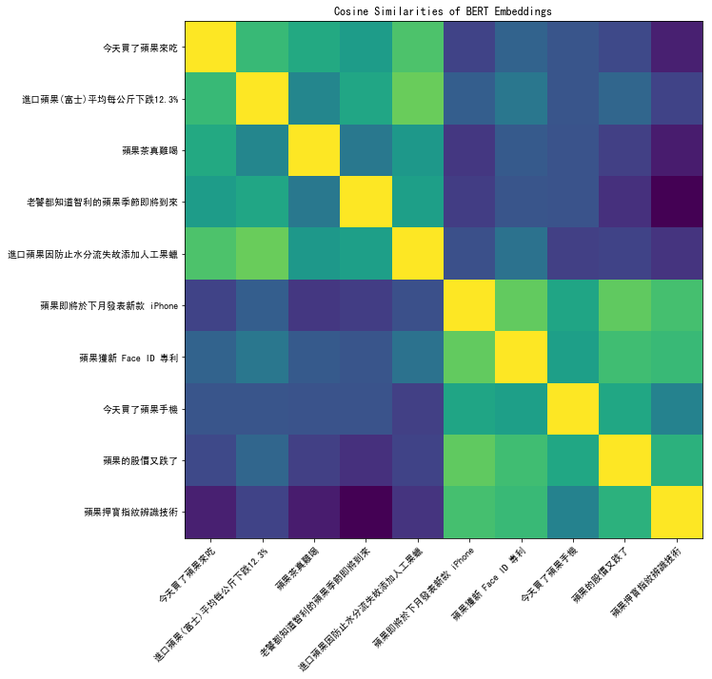
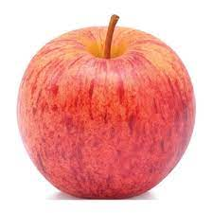

Notes:
https://colab.research.google.com/drive/1mWOWFdmI_f18Vo2HpxaVrauzlnAAWw2C

Slide 35
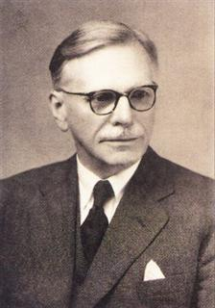
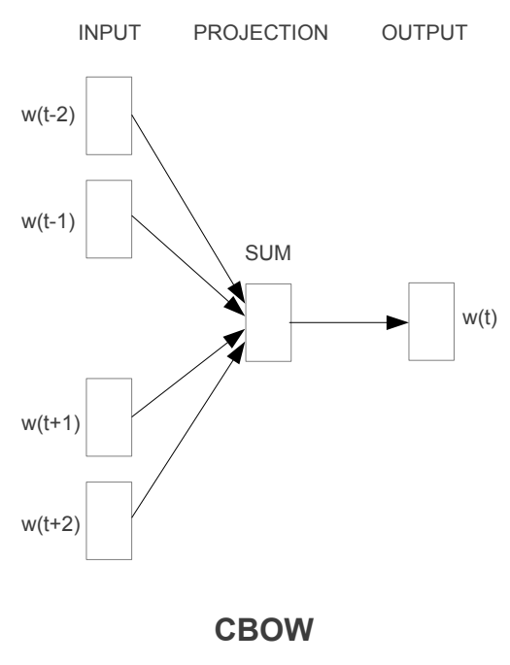
Why does BERT work?
You shall know a word by the company it keeps
Contextualized word embedding
w₂
John Rupert Firth
BERT
word embedding
w₁
w₂
w₃
w₄

Slide 36
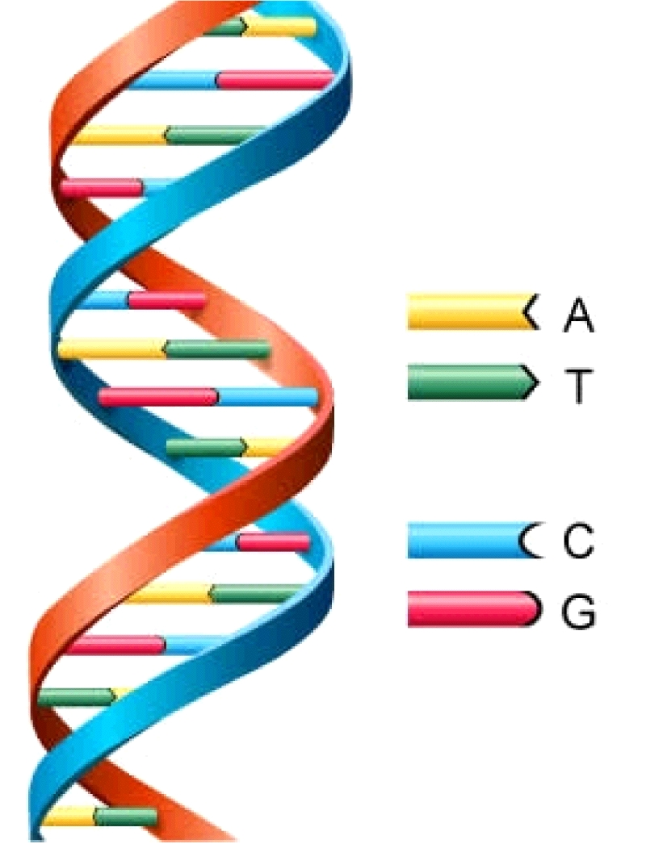
Why does BERT work?
https://arxiv.org/abs/2103.07162
This work is done by 高瑋聰
Applying BERT to protein, DNA, music classification
EI CCAGCTGCATCACAGGAGGCCAGCGAGCAGGTCTGTTCCAAGGGCCTTCGAGCCAGTCTG
EI AGACCCGCCGGGAGGCGGAGGACCTGCAGGGTGAGCCCCACCGCCCCTCCGTGCCCCCGC
IE AACGTGGCCTCCTTGTGCCCTTCCCCACAGTGCCCTCTTCCAGGACAAACTTGGAGAAGT
IE CCACTCAGCCAGGCCCTTCTTCTCCTCCAGGTCCCCCACGGCCCTTCAGGATGAAAGCTG
IE CCTGATCTGGGTCTCCCCTCCCACCCTCAGGGAGCCAGGCTCGGCATTTCTGGCAGCAAG
IE AGCCCTCAACCCTTCTGTCTCACCCTCCAGCCTAAAGCTCCTTGACAACTGGGACAGCGT
IE CCACTCAGCCAGGCCCTTCTTCTCCTCCAGGTCCCCCACGGCCCTTCAGGATGAAAGCTG
N CTGTGTTCACCACATCAAGCGCCGGGACATCGTGCTCAAGTGGGAGCTGGGGGAGGGCGC
N GTGTTACCGAGGGCATTTCTAACAGTCTTCTTACTACGGCCTCCGCCGACCGCGCGCTCG
N TCTGAGCTCTGCATTTGTCTATTCTCCAGCTGACCCTGGTTCTCTCTCTTAGCTACCTGC
class
DNA sequence

Slide 37
Why does BERT work?
https://arxiv.org/abs/2103.07162
This work is done by 高瑋聰
class
Linear
Random initialization
pre-train on English
Init by pre-train
A | we
T | you
C | he
G | she
BERT
[CLS]
we
she
we
he
DNA sequence
A
G
A
C

Slide 38
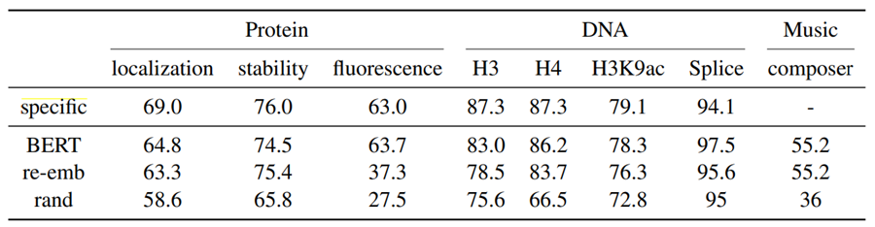

Why does BERT work?
https://arxiv.org/abs/2103.07162
This work is done by 高瑋聰
Applying BERT to protein, DNA, music classification
Notes:
https://ppfocus.com/hk/0/di75f00e4.html

Slide 39


To Learn More ……
BERT (Part 1)
BERT (Part 2)
https://youtu.be/1_gRK9EIQpc
https://youtu.be/Bywo7m6ySlk

Slide 40
Multi-lingual BERT
Multi-BERT
Multi-BERT
high
est
Mask
Mask
moun
tain
深
度
學
習
Training a BERT model by many different languages.
Notes:
You have an universal token set for all languages.

Slide 41
Zero-shot Reading Comprehension
Training on the sentences of 104 languages
Doc1
Query1
Ans1
Doc2
Query2
Ans2
Doc1
Query1
?
Doc3
Query3
Ans3
Doc3
Query3
?
Doc4
Query4
Ans4
Doc5
Query5
Ans5
Doc2
Query2
?
Train on English QA training examples
Test on Chinese
QA test
Multi-BERT
Notes:
Beto, Bentz, Becas: The Surprising Cross-Lingual Effectiveness of BERT
https://arxiv.org/abs/1904.09077

Slide 42
Zero-shot Reading Comprehension
English: SQuAD, Chinese: DRCD
Model | Pre-train | Fine-tune | Test | EM | F1
QANet | none | Chinese | Chinese | 66.1 | 78.1
BERT | Chinese | Chinese |  | 82.0 | 89.1
 | 104 languages | Chinese |  | 81.2 | 88.7
 |  | English |  | 63.3 | 78.8
 |  | Chinese + English |  | 82.6 | 90.1
F1 score of Human performance is 93.30%
This work is done by 劉記良、許宗嫄
https://arxiv.org/abs/1909.09587

Slide 43

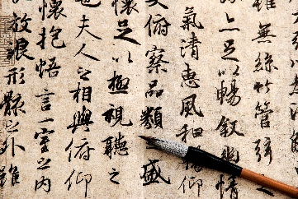
Cross-lingual Alignment?
跳
jump
游
兔
Multi-BERT
swim
rabbit
魚
fish
深
度
學
習
high
est
moun
tain
Notes:
https://www.youtube.com/watch?v=8rDN1jUI82g

Slide 44
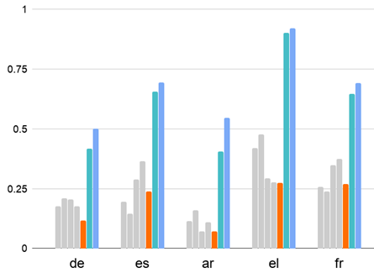
Mean Reciprocal Rank (MRR):
Higher MRR, better alignment
Google’s Multi-BERT
Our Multi-BERT
200k sentences for each lang
https://arxiv.org/abs/2010.10938
How about 1000k?
投影片來源: 許宗嫄同學碩士口試投影片
Notes:
https://en.wikipedia.org/wiki/Language_code
TH態文
EL希臘文

Slide 45
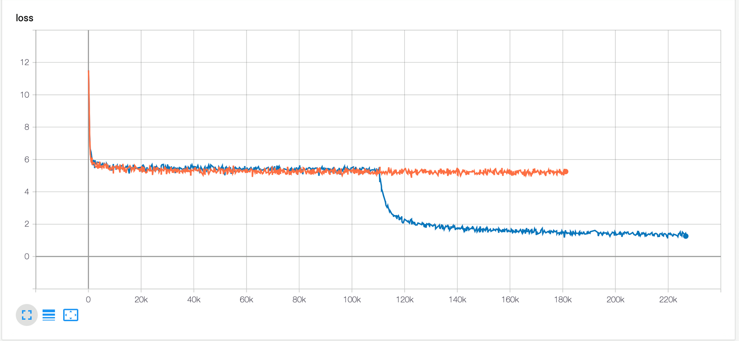
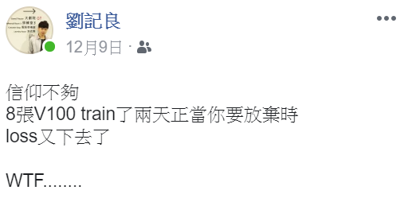
The training is also challenging …
Two days ……
(the whole training took one week)

Slide 46
Mean Reciprocal Rank (MRR):
Higher MRR, better alignment
The amount of training data is critical for alignment.
Google’s Multi-BERT
Our Multi-BERT
1000k sentences
Our Multi-BERT
200k sentences for each lang
https://arxiv.org/abs/2010.10938
投影片來源: 許宗嫄同學碩士口試投影片
Notes:
https://en.wikipedia.org/wiki/Language_code
TH態文
EL希臘文

Slide 47
https://arxiv.org/abs/2010.10041
Weird???
深
度
學
習
high
est
moun
tain
跳
jump
游
Reconstruction
兔
swim
rabbit
魚
fish
If the embedding is language independent …
Multi-BERT
How to correctly reconstruct?
There must be language information.
深
度
學
習
high
est
moun
tain

Slide 48
This work is done by 劉記良、許宗嫄、莊永松
Where is Language?
那
有
一
貓
跳
jump
Reconstruction
游
兔
swim
rabbit
魚
+
+
+
+
fish
Average of Chinese
Multi-BERT
Average of English
there
is
a
cat

Slide 49
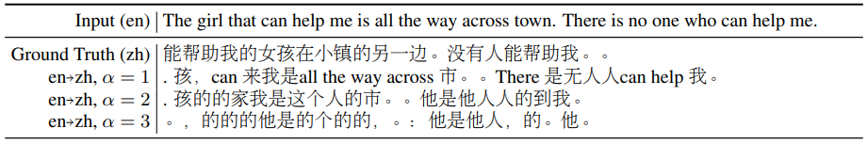
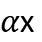
This work is done by 劉記良、許宗嫄、莊永松
If this is true …
https://arxiv.org/abs/2010.10041
跳
jump
Average of Chinese
游
兔
swim
$α$x
rabbit
魚
Average of English
fish
Unsupervised token-level translation ☺

Slide 50
Outline
BERT series
GPT series

Slide 51
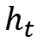
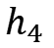
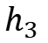
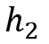

Predict Next Token
w_{t+1}
Training data: “台灣大學”
台
灣
大
學
Cross entropy
?
?
?
?
softmax
$$h_{1}$$
$$h_{2}$$
$$h_{3}$$
$$h_{4}$$
Linear
Transform
Model
from w_{t}
$$h_{t}$$
<BOS>
台
灣
大
Notes:
https://arxiv.org/abs/1802.05365

Slide 52

Predict Next Token
https://talktotransformer.com/
They can do generation.
Notes:
https://app.inferkit.com/generate

Slide 53


How to use GPT?
Description
A few example
Notes:
Two reason:
BERT has done
It is too large ……

Slide 54
“Few-shot” Learning
(no gradient descent)
“One-shot” Learning
“Zero-shot” Learning
“In-context” Learning

Slide 55

Average of 42 tasks

Slide 56

To learn more ……
https://youtu.be/DOG1L9lvsDY
Notes:
Self-supervised Learning: (or semi-supervied learning )
Good ref: https://lilianweng.github.io/lil-log/2019/11/10/self-supervised-learning.html
Scenario
Application: text, image, audio
Pretext:
Contrastive
SimCLR,
MoCo
Comparison of different approaches: https://arxiv.org/pdf/2011.10566v1.pdf
No negative - BOYL
Why it work: https://www.untitled-ai.com/understanding-self-supervised-contrastive-learning.html
Prediction
Reconstruction
Teacher / Student
Self-training with Noisy Student improves ImageNet classification
Billion-scale semi-supervised learning for image classification
Self-training v.s. Self-supervied learning
https://medium.com/%E8%BB%9F%E9%AB%94%E4%B9%8B%E5%BF%83/deep-learning-self-training%E7%95%B6%E9%81%93-%E5%B0%8D%E6%AF%94pre-training%E7%9A%84%E5%84%AA%E7%BC%BA%E9%BB%9E-4f1b5a937c5d
Other task:
Unsupervised Representation Learning by Predicting Image Rotations https://arxiv.org/pdf/1803.07728.pdf
Unsupervised Learning of Visual Representations by Solving Jigsaw Puzzles https://arxiv.org/abs/1603.09246
Tracking Emerges by Colorizing Videos
Weird thing:
https://research.aimultiple.com/self-supervised-learning/

Slide 57
Beyond Text
NLP
Speech
CV
Data Centric
Prediction
Contrastive
Position, 2015
RNNLM, 1997
APC, 2019
InfoNCE, 2017
CPC, 2019
Jigsaw, 2017
word2v, 2013
audio2v, 2019
SimCLR, 2020
MoCo, 2019
Rotation, 2018
Cutout, 2015
BERT, 2018
Mock, 2020
MoCov2, 2020
TERA, 2020
BYOL, 2020
本投影片由劉廷緯同學提供
SimSiam, 2020

Slide 58


Image - SimCLR
https://arxiv.org/abs/2002.05709
https://github.com/google-research/simclr

Slide 59

Image - BYOL
Bootstrap your own latent:
A new approach to self-supervised Learning
https://arxiv.org/abs/2006.07733

Slide 60


Speech
BERT
Audio version
深
度
學
習
Notes:
http://superbbenchmark.org/

Slide 61
Speech GLUE - SUPERB
Speech processing Universal PERformance Benchmark
Will be available soon
Downstream: Benchmark with 10+ tasks
The models need to know how to process content, speaker, emotion, and even semantics.
Toolkit: A flexible and modularized framework for self-supervised speech models.
https://github.com/s3prl/s3prl

Slide 62

https://github.com/andi611/Self-Supervised-Speech-Pretraining-and-Representation-Learning
Notes:
self-supervised speech

Slide 63
Appendix
(a joke)

Slide 64

Predict Next Token
They can do generation.
Notes:
https://talktotransformer.com/
https://disp.cc/b/115-bC2b

Slide 65

律師
Notes:
əˈtərnē

Slide 66

混亂
Notes:
ˈanərkē

Slide 67



I forced a bot to watch over 1,000 hours of XXX
是一個梗!
人在模仿機器模仿人!!!

